Slide 1
Building a Game Studio to Develop Mobile Game
Group 1：Ashok Thiruvengadam | Rahul Rudra | Tianyu Chang | Sindhu Koppisetti | Aditya Abhijeet Hongunti

Slide 2

Project objectives
EPM Summer 2022
Objectives
Our objective is to setup a mobile game studio and to develop 5-6 games. We are planning to create our hub in San Francisco as there are lot of investors in Silicon
Valley. We can pitch our idea and attract funding. And most of our R&D staffs can be based in Bengaluru, India. As we can get highly skilled technical manpower and since labor cost is low. Thus, we can cut down our expenditure in employee salary.
We will break our project into different phases and track the desired outcome. We are planning to implement Agile methodology for effective product development.

Slide 3

Project objectives
EPM Summer 2022
Critical Success Factors
1. Setting up the Team like Recruitment of Solution Architects, Designers, Development Managers, Coders.
2. Procurement of High-end Devices like Computers, Servers, graphic cards.
3. Meeting the Deadlines.
4. Good Budget Plan and making sure of not exceeding the allotted one.
5. Good Teamwork between all the stake holders.
6. Compliance with all the game standards as per the experts.
7. Office spaces and equipment’s are leased to save cost.
8. Taking advantage of all startup funds and startup aids for acquiring devices and licenses.

Slide 4

Project objectives
EPM Summer 2022
Assumptions
1.A good workplace to work with at least 2000 sq.ft with constant supply of electricity.
2. Skilled labor is recruited in both India and U.S
3.All the legal permissions are acquired.
4. Game is accepted by Device platforms.
5. Game is a good hit in the market.

Slide 5
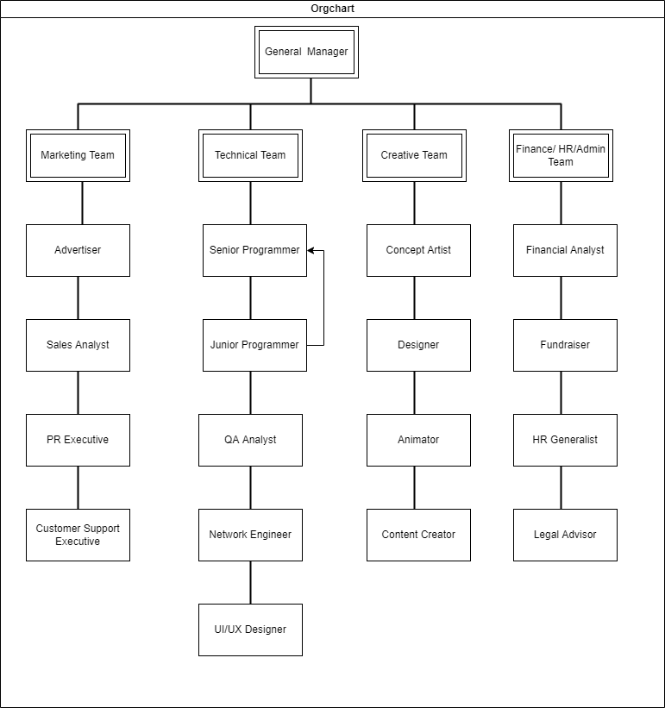
Project organization
EPM Summer 2022

Slide 6
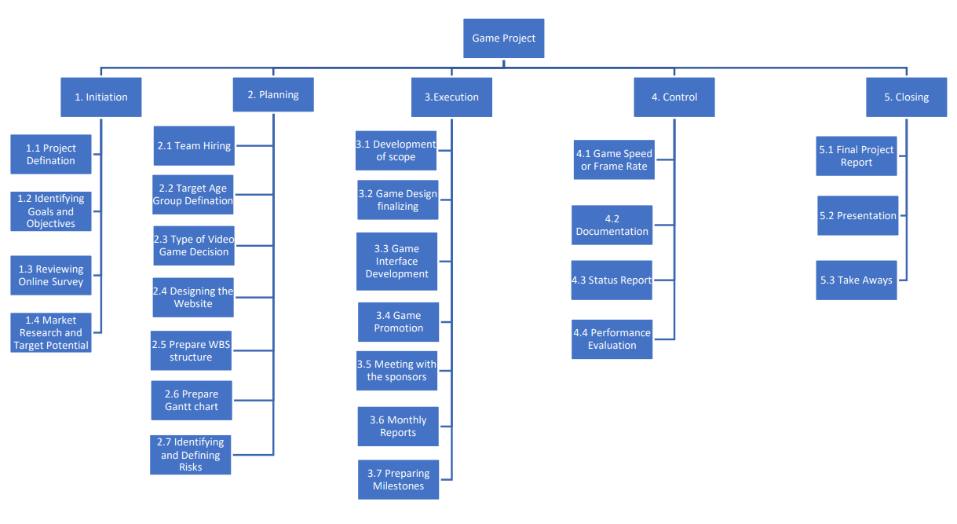
Implementation plan
EPM Summer 2022
Work Breakdown Structure（WBS）

Slide 7
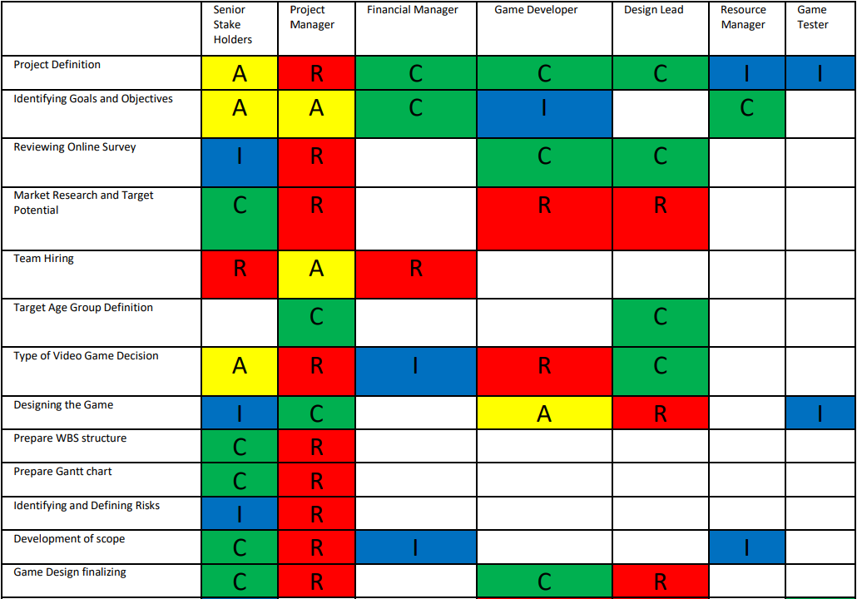
Implementation plan
EPM Summer 2022
RACI Chart（I）

Slide 8
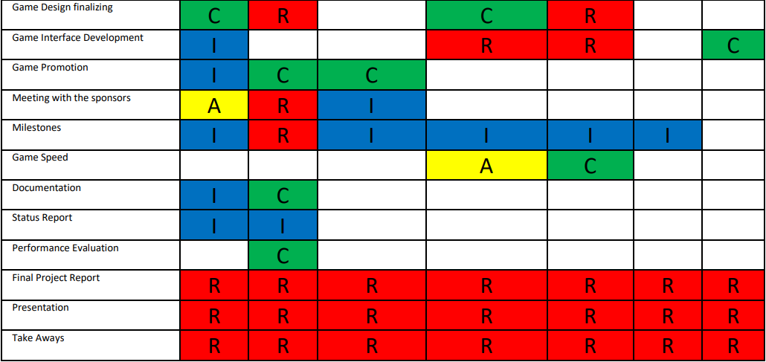
Implementation plan
EPM Summer 2022
RACI Chart（II）

Slide 9
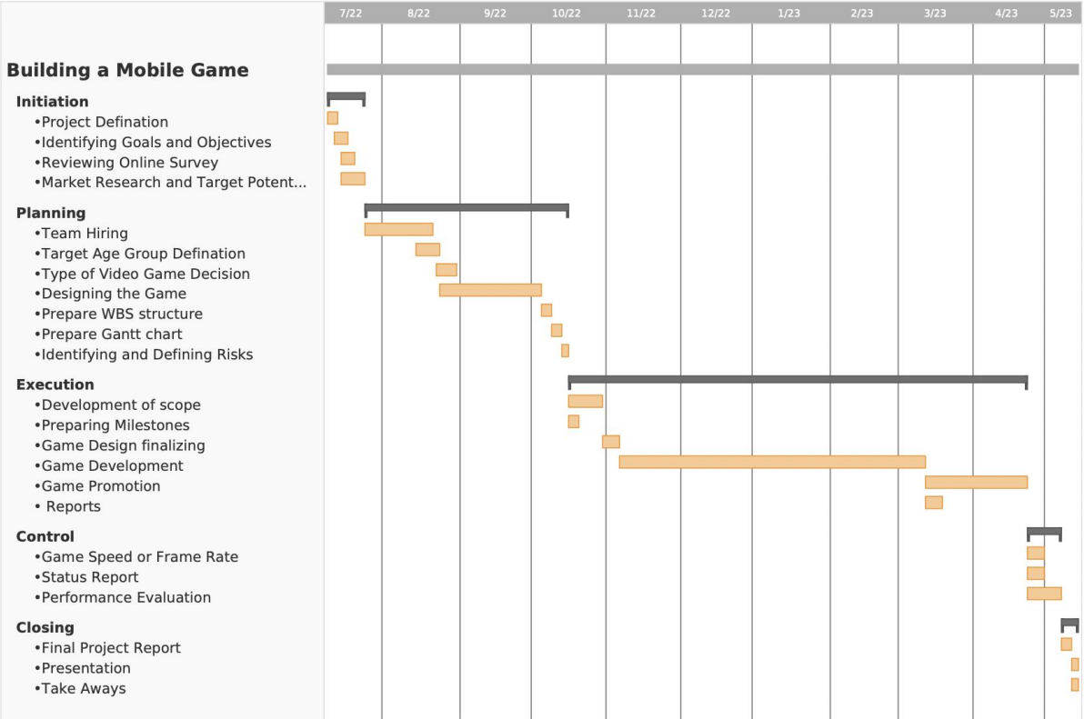
Implementation plan
EPM Summer 2022
Gantt Chart

Slide 10

Risk Analysis
EPM Summer 2022
The Top 10 Risks possible
1. Development strategy
2. Human resources and Manpower
3. Schedule
4. Budget governance
5. Inadequate Details or specifications
6. Fun Factor
7. Management Change
8. Errors
9. Mutual Trust
10. Higher level Support

Slide 11
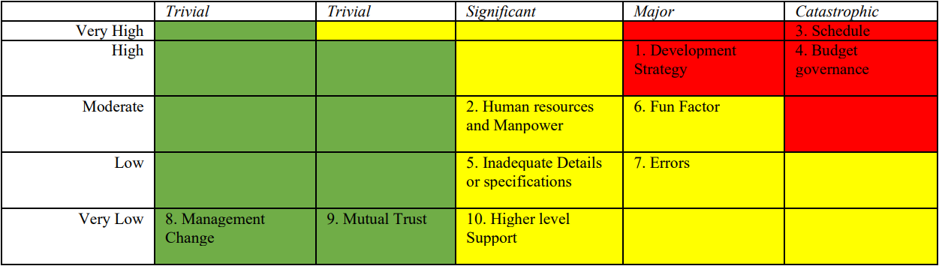
Risk Analysis
EPM Summer 2022
Qualitative Risk Analysis
A qualitative risk analysis will help you in identifying any particular categories or types of risks that need to receive more attention or any impact of risks that need to be dealt right away.

Slide 12
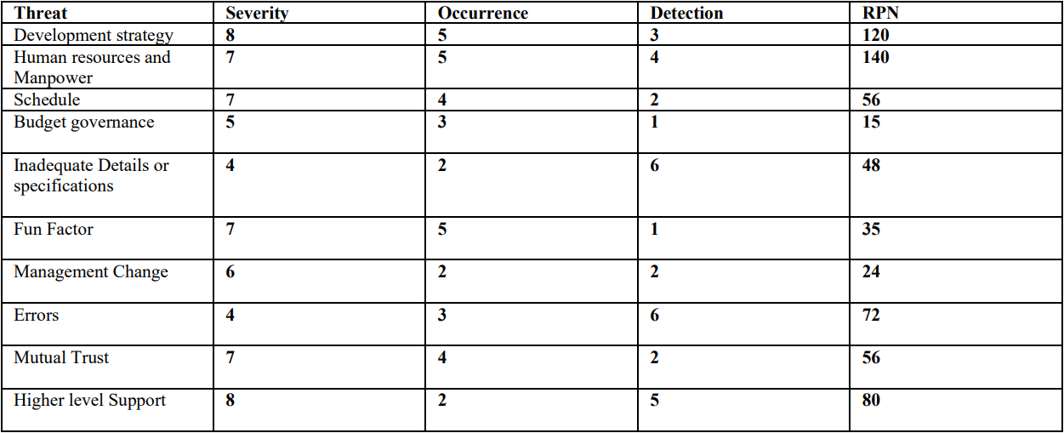
Risk Analysis
EPM Summer 2022
Quantitative Risk Analysis
For the Quantitative Risk Analysis, we have used FMEA analysis on our project, it helps us with the information related to our risks associated with projects which in turn can help us in applying already established safety measures. And in FMEA we have used RPN approach to analyze our Risks. After going through the different risks and their affects, we were able to generate a result shown below:

Slide 13
Monitoring and control
EPM Summer 2022
Monitoring
For monitoring the first task is to examine the WBS in order to extract scope, time, and cost goals. Alderton (2013) suggests five telltale signs of project trouble it is wise to monitor: Muddy Waters, Mysterious Stakeholders, Unconstrained Constraints, Suspicious Status Reports and Discord and Drama. PMs need to monitor each phases of project these 5 aspects.
Execution phase
Mysterious stakeholders monitoring → development
Suspicious status reports monitoring → game interface development, game design
Initiation phase
Control phase
muddy waters monitoring →
identifying goals and object
suspicious status reports monitoring →
game speed
Planning phase
Closing phase
mysterious stakeholders monitoring
discord and drama→after team hiring
mysterious stakeholders and discord and drama monitoring → after presentation and publish

Slide 14
Monitoring and control
EPM Summer 2022
Human resource control
Process control
Physical asset control
When the team wants to recruit a new staff to work on our company, we need multiple evaluation to ensure the new staff could be competent for the job. Also, we want to get the right person at the lowest possible salary.
When a task was finished, the result would be compared with a standard, to evaluate its effect, although this step needs more people to execute, it can further ensure that our project has a certain quality and is on the original track.
Physical asset refers to computer, desk and chair, viewing screen and refrigerators, coffee makers, etc. in common areas.

Slide 15
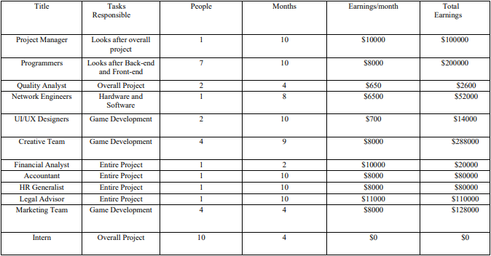
Financial plan
EPM Summer 2022
The following assumptions have been made while making the financial plan:
No overhead or miscellaneous cost are included
2. The salary of employees is quoted based on average salary taken from labor statistics
3. Most of the technical staffs are hired from India to cut down cost and unpaid interns are also hired to cut down cost
4. Most of the high-end devices are rented and virtually rented as it is cheaper
5. Employees are hired in contractual manner and in phase wise based on the needs
The following table depicts the estimated expenses of salaries working on the project：

Slide 16
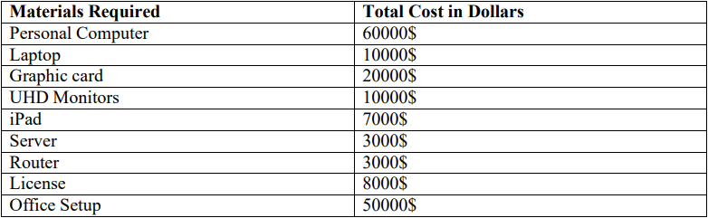
Resource allocation
EPM Summer 2022
The following table has information about the materials required and its cost
Cost Benefit Analysis
Some of the assumptions taken into consideration before performing Cost benefit analysis are:
Based on the current trend a successful game is well received by gamers up to 5 years
2. The annual operational and maintenance cost is 30000$
3. The estimated revenue of the game when downloaded by 10 million plus users is150000$ per 3 months
4. The minimum attractive rate of return of our game is 35%

Slide 17
Conclusion
EPM Summer 2022
With gaming industry growth booming with 3.24 billion gamers across the globe and with covid restrictions attracting more gamers. It is great time to start a gaming studio. And we have a higher of chance of creating a trendy game by launching a free version of mind game in multiple genres across 2 major platforms supporting various devices.
Our gaming studio has all the characteristics to become a successful one. With 90% of startup failing without clear scope, goals, and mismanagement of funds. However, a well-defined and a well-planned project combined with risk assessment and monitoring of processes, the organization can overcome these problems.
By effective fund raising and by following the project plan closely by the team and monitoring of the milestones and the budget we can achieve a successful venture. And this venture can generate continuous income at minimal maintenance cost and adding updates to the current game and by placing advertisements which also included in the project plan along with budget and timeline.
Through this we can setup a highly profitable gaming company which can generate Recurring revenue.

